Slide 1
Causes and Predictors of Mortality among People who Inject Drugs in Tijuana: 2011-2017
IAS Conference: July 23, 2018
Brooke S. West, Daniela Abramovitz, Patricia E. Gonzalez-Zuniga, Gudelia Rangel, Dan Werb, Javier Cepeda, Leo Beletsky, and Steffanie Strathdee
Notes:
Good afternoon. Today I am discussing the causes and predictors of mortality among people who inject drugs in Tijuana, Mexico.

Slide 2
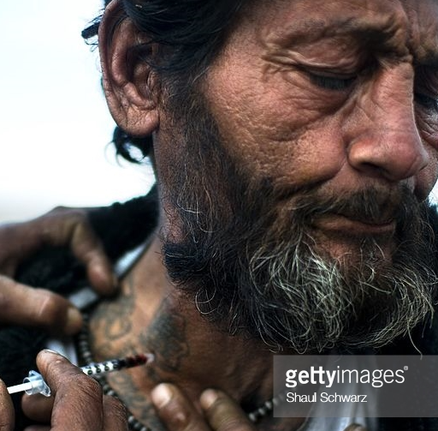
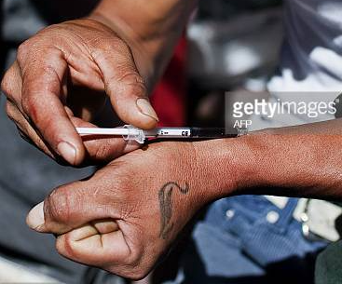
Background
What are the causes and predictors of death among people who inject drugs (PWID) in Tijuana, Mexico?
Busiest US-Mexico border crossing, a major drug trafficking route, and a large sex market.
~10,000 PWID in Tijuana and high levels of homelessness and public injecting.
HIV prevalence is 4% among PWID.
Access to affordable medication-assisted treatment for opioid dependence (MAT) is limited.
Changes to drug policy in 2009 shape context for PWID.
Photo Credit: Ronaldo Schemidt/Getty
Photo Credit: Ronaldo Schemidt/Getty
Notes:
It is well established that people who inject drugs (PWID) are at increased risk of mortality; however, more research is needed on the causes and predictors of death in contexts, like Mexico, and in border communities, like Tijuana. There are an estimated 10,000 PWID living in Tijuana, a city with substantial markets for drugs and sex work that is also one of the busiest border crossings in the world. HIV prevalence among PWID is 4%, with higher rates among key sub-populations, like female PWID who trade sex (12%). However, HIV is only one factor that may underlie increased risk for mortality as Tijuana is characterized by high levels of homelessness and public injecting, but also limited opportunities for access to quality affordable drug treatment.
In Mexico, recent changes in legislation also impact the lives of PWID. New drug policies, which passed in 2009, both decriminalized the possession of small quantities of illegal substances and mandated the expansion of addiction treatment with the expectation that police would divert individuals to treatment.

Slide 3
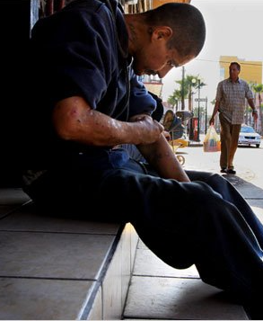
Methods
Community-based cohort of 863 PWID aged ≥18 who injected drugs in the past month (El Cuete Study).
Mortality was confirmed by death certificate over 78 months between April 2011 and December 2017.
We also report mortality rates for unconfirmed deaths.
Predictors of mortality rate (for confirmed deaths) were identified using Poisson regression with empirical variance estimation, controlling for sex.
Photo Credit: Sandy Huffaker, NY Times
Notes:
Proyecto El Cuete is a prospective community-based cohort of PWID in Tijuana, Mexico, which includes individuals aged 18 or older who reported injecting drugs in past 30 days. Study participants were recruited through self-referral, word of mouth, and street outreach.
This analysis included PWID recruited between April 2011 and December 2017. The primary outcome was all-cause mortality rates, which was determined by death certificate, confirmed deaths, or through ongoing follow up with contacts provided by participants, which we call unconfirmed deaths. Mortality rates were calculated using person-time for the total sample and separately by HIV status. A multivariable model was constructed by using Poisson regression to examine variables associated with time to all-cause mortality.

Slide 4
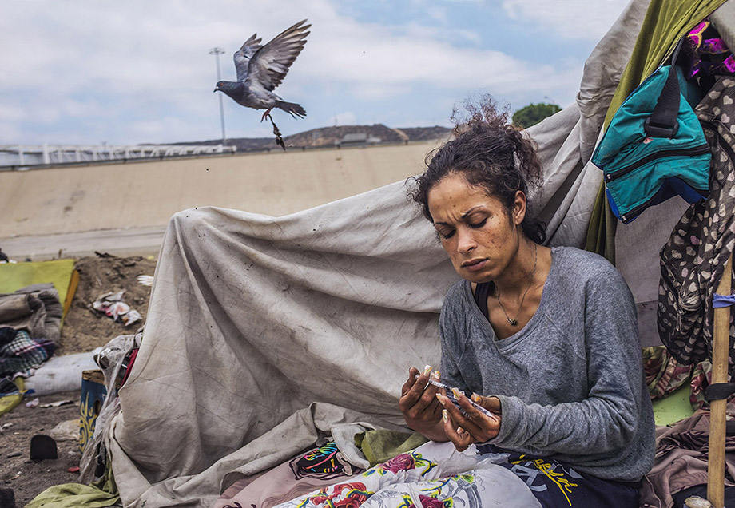
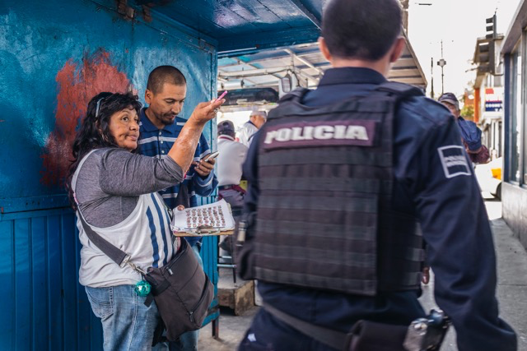
Key Findings
Mortality Rates
Deaths:
57 Confirmed
76 Unconfirmed
Causes of Mortality:
26% Homicide/trauma
26% Overdose
9% HIV
PWID Mortality Rates:
18-39 per 1000PY
46-103 per 1000PY among HIV+ PWID
Multivariate Results
Baseline HIV seropositivity was associated with a 4X greater risk.
Arrest for drug sales was associated with a 6X greater risk.
Cessation of injection, even for short periods of time, was associated with a lower risk.
Photo Credit: Malcolm Linton/Polaris
Photo Credit: Malcolm Linton/Polaris
Notes:
A total of 863 eligible individuals were followed for up to 78 months. There were 133 deaths (57 confirmed, 76 unconfirmed), with an incidence density of mortality of 18 deaths per 1000 person-years for confirmed deaths and 39 for all deaths, including unconfirmed ones. Mortality rates were substantially higher among PWID who were HIV+. Confirmed deaths resulted primarily from homicide/trauma (26%), overdose (26%), septic shock (18%), HIV-related causes (9%) and substance use related causes [organ failure from chronic substance use (9%), Hepatitis C (7%), and tuberculosis (5%].
Baseline HIV seropositivity was associated with 4X higher risk of mortality and being arrested for drug sales was associated with 6X higher risk of mortality. Stopping injection for a period of ≥6 months was protective.

Slide 5
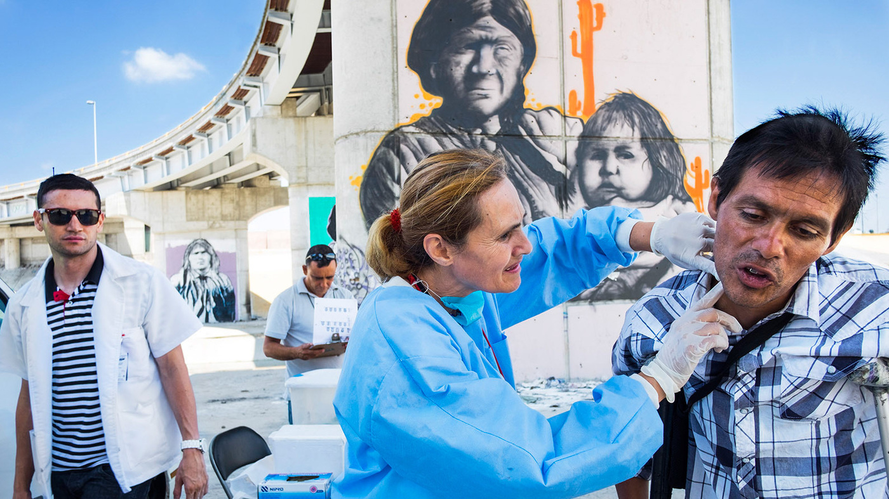
Conclusions
High PWID mortality rates stemmed from HIV, but also other structural factors.
There is a need for improved access to no-cost ART and MAT to reduce mortality.
Safe consumption facilities and alternative income acquisition opportunities could also make PWID safer.
Further reform, training, and other interventions are needed to ensure that law enforcement encounters result in linkage to care.
Photo Credit: Malcolm Linton/Polaris
Notes:
The mortality rate for PWID was high and stemmed from HIV, but also from factors associated with the structural context. Particularly concerning, was that over half of all deaths stemmed from preventable causes, like homicide or overdose, which suggests that there is a need for public health efforts to reduce marginalization, create safer environments such as supervised consumption facilities, and to ensure that PWID have access to medication-assisted drug treatment .
Similar to other studies, HIV infection was also a major factor contributing to high rates of mortality. In Mexico, health care is universal, including ART; however, access can be limited, especially for stigmatized populations. Previous studies have shown that in Tijuana, PWID relative to non-PWID were the least likely to have been previously tested or to have initiated HIV care, suggesting a need to improve the HIV care continuum for PWID.
Of note, interactions with police, specifically being arrested for drug sales, was a highly significant predictor of mortality. Despite drug law reforms designed to shift to a public health model, research suggests that police encounters for PWID are common, including arrest, detainments, harassment and violence. Our results suggest that interactions with police, which could serve as an opportunity to connect PWID with supportive services, may instead be a source and facilitator of health harms. Trainings and other structural interventions focused on the integration of law enforcement and public health continue to be needed to reduce mortality among PWID in this context. Additionally, these results point to the need to develop alternative income generation strategies for drug-involved communities so that individuals don’t have to rely on the drug trade for economic survival.
Finally, we found that even short periods of injection cessation were associated with lower risk of mortality, which indicates a need for improved access to MAT to reduce injecting. At the time of this analysis, however, there were three private methadone maintenance clinics operating in Tijuana, all which charged a fee, which can make treatment unattainable for PWID who are often economically marginalized.
Overall, the high rates of mortality among PWID presented here should serve as a call to action for public health agencies to prioritize the lives of this population by preventing their deaths.

Slide 6
FUNDING
This study was funded by NIH/NIDA R37DA019829 (PI: Strathdee). Dr. West is funded by NIH/NIDA K01DA041233(PI: West) and by Fogarty-funded GloCal R25TW009343 from the UC Global Health Institute.
CONFLICTS
No conflicts of interest to report
Thank you!
Notes:
Thank you so much for your time. I look forward to your questions.

